Slide 1
II Crystal Structure
2-1 Basic concept
♦ Crystal structure = lattice structure + basis
♦ Lattice points: positions (points) in the
structure which are identical.
X
X
X
X
X
X
X
X
X
X
X
X
X
X
X
X
lattice point
Not a lattice point?

Slide 2
♦ Lattice translation vector
♦ Lattice plane
♦ Unit cell
♦ Primitive unit cell【1 lattice point/unit cell】
Examples : CsCl
Fe (ferrite) b.c.c (not primitive)
Al f.c.c (not primitive)
Mg h.c.p simple hexagonal lattice
Si diamond f.c.c (not primitive)

Slide 3
√
Rational direction
integer
Cartesian coordinate
Use lattice net to describe is much easier!
Rational direction & Rational plane are chosen to describe
the crystal structure!

Slide 4
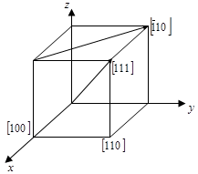
2-2 Miller Indices in a crystal (direction, plane)
2-2-1 direction
The direction [u v w] is expressed as a vector
The direction <u v w>are all the [u v w] types of direction, which are crystallographic equivalent.

Slide 5
2-2-2 plane
The plane (h k l) is the Miller index of the
plane in the figure below.
{h k l} are the (h k l) types of planes which are crystllographic equivalent.

Slide 6
You can practice indexing directions and planes
in the following website
http://www.materials.ac.uk/elearning/matter/Crystallography/IndexingDirectionsAndPlanes/index.html

Slide 7
Crystallographic equivalent?
Example:
(hkl)
Individual plane
{hkl}
Symmetry related set
{100}
z
y
x
z
{100}
Different
Symmetry
related set
y
x

Slide 8
2-2-3 meaning of miller indices
>Low index planes are widely spaced.
x
[120]
(110)

Slide 9
>Low index directions correspond to short
lattice translation vectors.
y
x
[120]
[110]
>Low index directions and planes are
important for slip, cross slip, and electron
mobility.

Slide 10
2-3 Miller Indices and Miller - Bravais Indices
(h k l) (h k i l)
2-3-1 in cubic system
Direction [h k l] is perpendicular to (h k l)
plane in the cubic system, but not true for
other crystal systems.
x
y
x
y
[110]
(110)
[110]
(110)
|x| = |y|
|x| ≠ |y|

Slide 11
2-3-2 In hexagonal system
using Miller - Bravais indexing system:
(hkil) and [hkil]
y
[010]
Miller indces
x
[100]
[110]
Reason (i): Type [110] does not equal to [010] , but these directions are crystallographic equivalent.
Reason (ii): z axis is [001], crystallographically distinct from [100] and [010]. (This is not a reason!)

Slide 12
If crystal planes in hexagonal systems are indexed using Miller indices, then crystallographically equivalent planes have indices which appear dissimilar.
the Miller-Bravais indexing system
(specific for hexagonal system)
http://www.materials.ac.uk/elearning/matter/Crystallography/IndexingDirectionsAndPlanes/indexing-of-hexagonal-systems.html

Slide 13



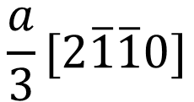
2-3-3 Miller-Bravais indices
(a) direction
The direction [h k i l] is expressed as a vector
$$[\overline{1}\overline{1}20]$$
$$[\overline{1}2\overline{1}0]$$
$$[2\overline{1}\overline{1}0]$$
Note :
$$\frac{a}{3}[2\overline{1}\overline{1}0]$$
is the shortest translation
vector on the basal plane.

Slide 14


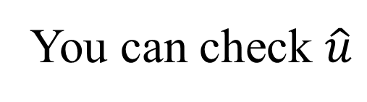
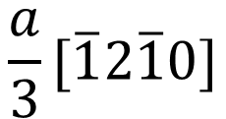
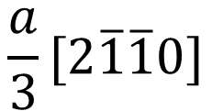
$$\frac{a}{3}[2\overline{1}\overline{1}0]$$
$$\frac{a}{3}[\overline{1}2\overline{1}0]$$
$$[100]$$
$$[010]$$
You can check $\hat{u}$

Slide 15
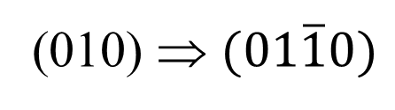
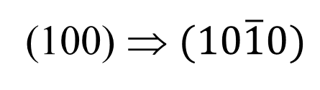
planes (h k i l) ; h + k + i = 0
Plane (h k l) → (h k i l)
(010) ⇒ $(01\overline{1}0)$
(100)
plane
plane
(100) ⇒ $(10\overline{1}0)$

Slide 16
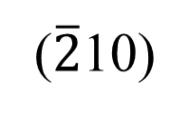

(h k l)
(h k i l)
? plane
($\overline{2}$10)
$$(\overline{2}110)$$

Slide 17

Proof for general case:
For plane (h k l), the intersection with the basal plane (001) is a line that is expressed as
Check back to page 5
$$\frac{x}{\frac{1}{h}}+\frac{y}{\frac{1}{k}}=1$$
line equation :
Where we set the lattice constant a = b = 1 in the hexagonal lattice for simplicity.
line equation :

Slide 18
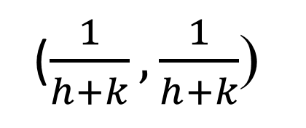
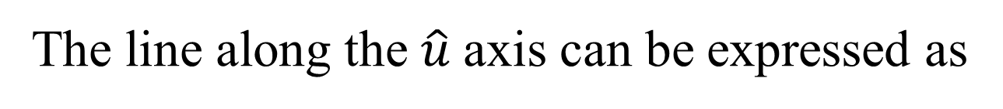

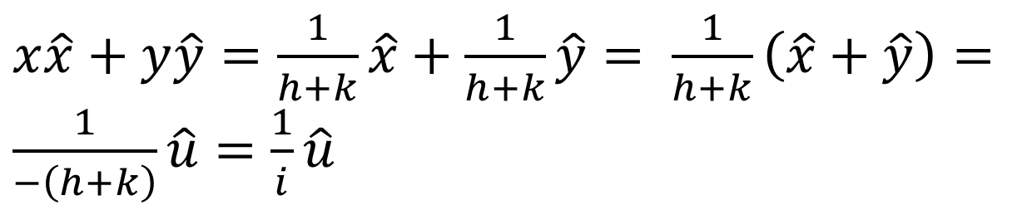
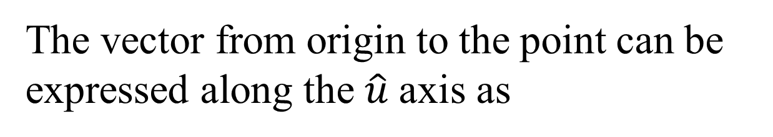



The line along the $\hat{u}$axis can be expressed as
line equation :
$$x=y$$
or
$$x−y=0$$
Intersection points of these two lines
$$hx+ky=1$$
and
$$x−y=0$$
is at
($\frac{1}{h+k},\frac{1}{h+k}$)
The vector from origin to the point can be expressed along the $\hat{u}$axis as
$x\hat{x}+y\hat{y}=\frac{1}{h+k}\hat{x}+\frac{1}{h+k}\hat{y}= \frac{1}{h+k}\left(\hat{x}+\hat{y}\right)=\frac{1}{−\left(h+k\right)}\hat{u}=$ $\frac{1}{i}\hat{u}$
⇒ i = - (h + k)

Slide 19

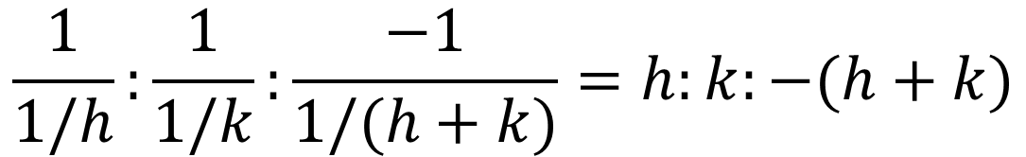
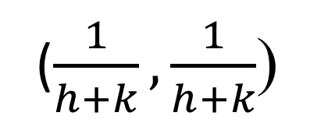
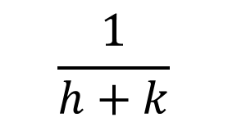

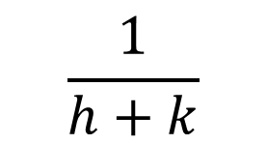

($\frac{1}{h+k},\frac{1}{h+k}$)
$$\frac{1}{h+k}$$
?
$$\frac{1}{k}$$
$$\frac{1}{h+k}$$
$$\frac{1}{h}$$
$$\frac{1}{h+k}$$
$$\frac{1}{1/h}:\frac{1}{1/k}:\frac{−1}{1/(h+k)}=h:k:−(h+k)$$

Slide 20

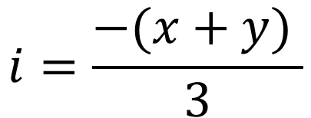
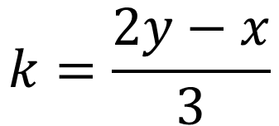
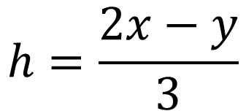
(c) Transformation from Miller [x y z] to
Miller-Bravais index [h k i l]
rule
$$h=\frac{2x−y}{3}$$
$$k=\frac{2y−x}{3}$$
$$i=\frac{−(x+y) }{3}$$
$$z=l$$

Slide 21







Proof:
The same vector is expressed as [x y z] in
miller indices and as [h k I l] in
Miller-Bravais indices!
$$\left[x y z\right]=x\hat{x}+y\hat{y}+z\hat{z}$$
$$\left[h k i l\right]=h\hat{x}+k\hat{y}+i\hat{u}+l\hat{z}$$
$$=h\hat{x}+k\hat{y}+i\left(−\hat{x}−\hat{y}\right)+l\hat{z}$$
$$=\left(h−i\right)\hat{x}+\left(k−i\right)\hat{y}+l\hat{z}$$
$x=h$ $−$ $i$
⇒
$y$ $=$ $k−i$
$z$ $=$ $l$

Slide 22
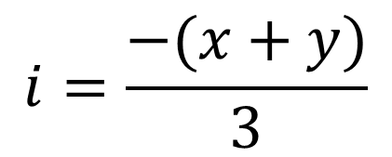
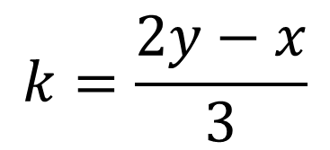
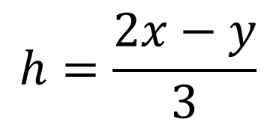
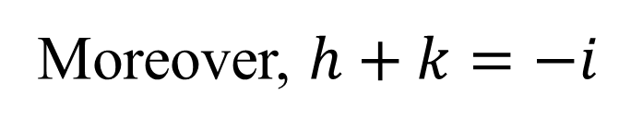


Moreover, $h+k=−i$
$$x=h−i=h+h+k=2h+k$$
⇒
$$y=k−i=k+h+k=h+2k$$
$$z=l$$
$$h=\frac{2x−y}{3}$$
$$k=\frac{2y−x}{3}$$
$$i=\frac{−(x+y)}{3}$$
⇒
⇒
$$z=l$$

Slide 23






2-4 Stereographic projections
2-4-1 direction
$$[u v w]$$
$$[h k l]$$
Horizontal
plane
$$[\overline{u} \overline{v} \overline{w}]$$
$$[h k l]$$
$$[u v w]$$
$$[\overline{u} \overline{v} \overline{w}]$$

Slide 24
Representation of relationship of planes and
directions in 3D on a 2D plane. Useful for the
orientation problems.
A line (direction) → a point.

Slide 25
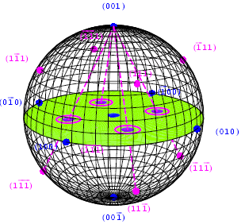

Slide 26
(100)

Slide 27
2-4-2 plane
Great circle: the plane passing through the center of the sphere.

Slide 28
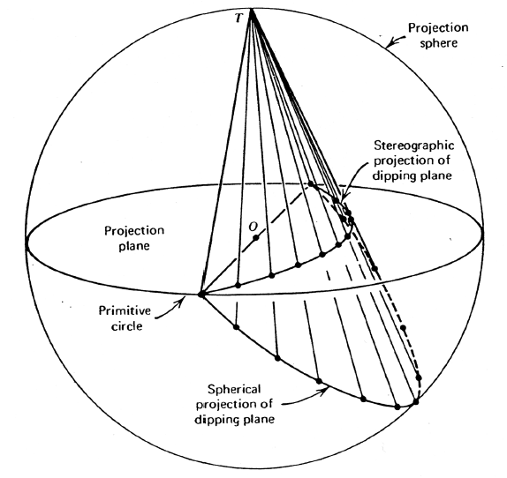
http://courses.eas.ualberta.ca/eas233/0809winter/EAS233Lab03notes.pdf
A plane (Great Circle) → trace

Slide 29
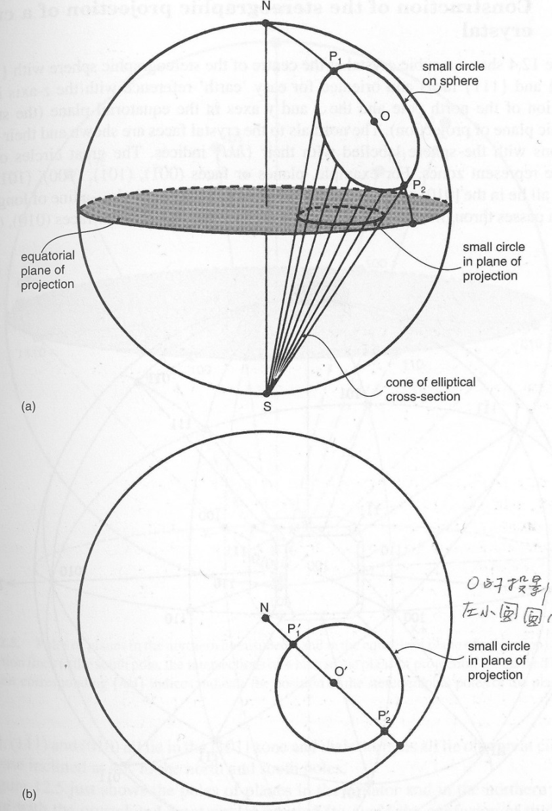
Small circle: the plane not passing through the center of the sphere.
B.D. Cullity

Slide 30
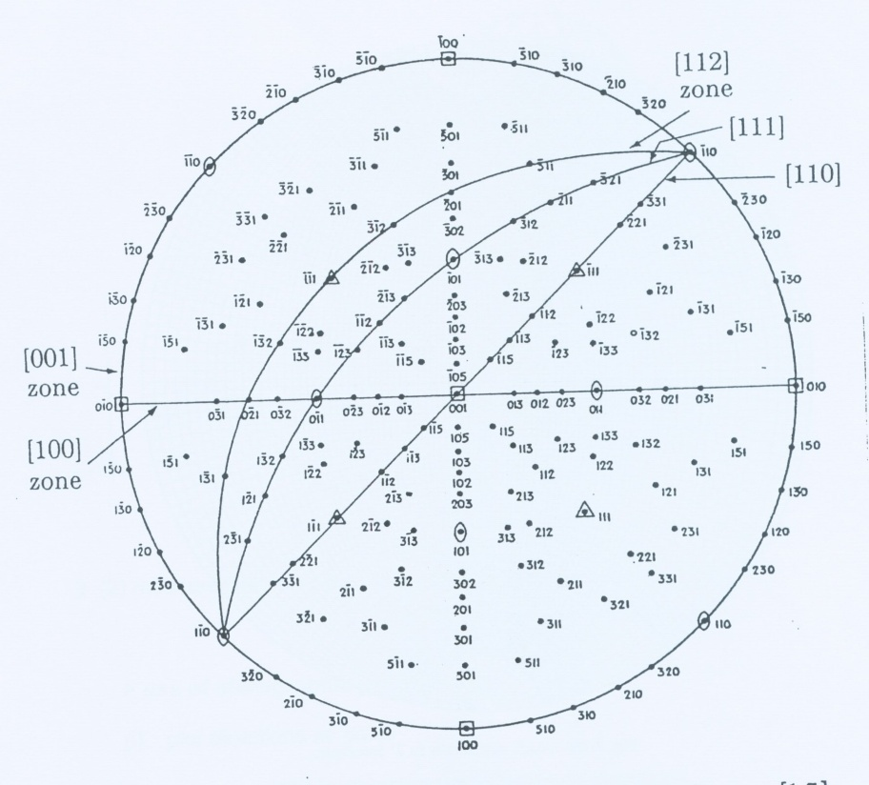
Example: [001] stereographic projection; cubic
Zone
axis
B.D. Cullity

Slide 31
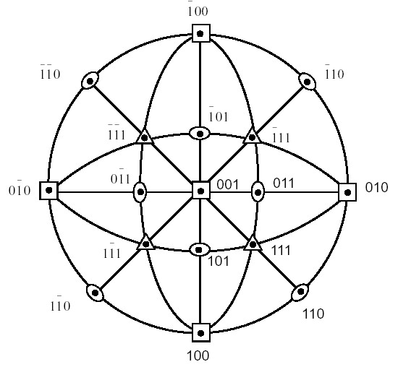
2-4-2 Stereographic projection of different
Bravais systems
Cubic

Slide 32



How about a standard (011) stereographic
projection of a cubic crystal?
$$\hat{x}$$
$$\hat{y}$$
$$\hat{z}$$
Start with what you know!
What does (011) look like?

Slide 33
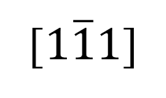

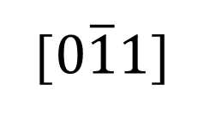

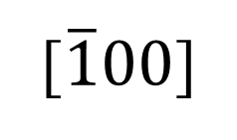
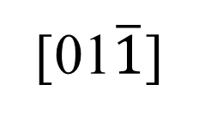

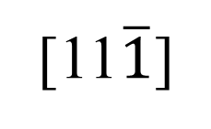
$$\hat{x}$$
[01$\overline{1}$]
[$\overline{1}00$]
(011)
[100]
$$\hat{y}$$
$$\hat{z}$$
[$0\overline{1}1$]
[11$\overline{1}$]
[$1\overline{1}1$]
109.47º
(011)
70.53º

Slide 34
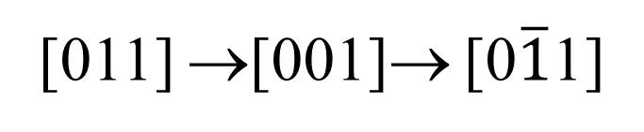

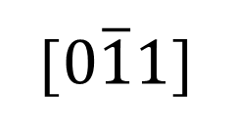

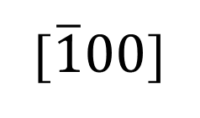
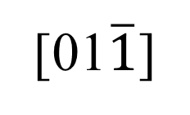

[011] →[001]→ [0$\overline{1}$1]
$$\hat{x}$$
[01$\overline{1}$]
[$\overline{1}00$]
(011)
[100]
$$\hat{y}$$
$$\hat{z}$$
[001]
[$0\overline{1}1$]
45º
[011]

Slide 35

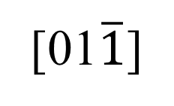
[011] →[111]→ [100]
[100]
[111]
$$\hat{x}$$
[01$\overline{1}$]
[$\overline{1}00$]
35.26º
(011)
$$\hat{y}$$
$$\hat{z}$$
[011]
[$0\overline{1}1$]

Slide 36
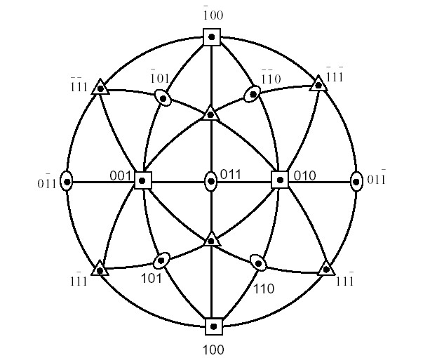

$$\overline{1}10$$
111

Slide 37
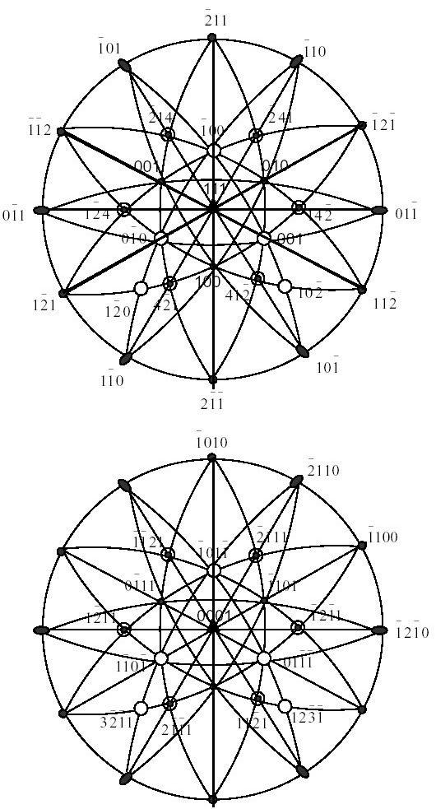
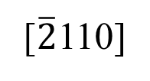
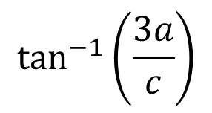
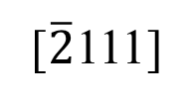
Trigonal
Hexagonal
3a
[0001]
[$\overline{2}$111]
c
$$\tan^{−1}\left(\frac{3a}{c}\right)$$
3a
[$\overline{2}$110]

Slide 38
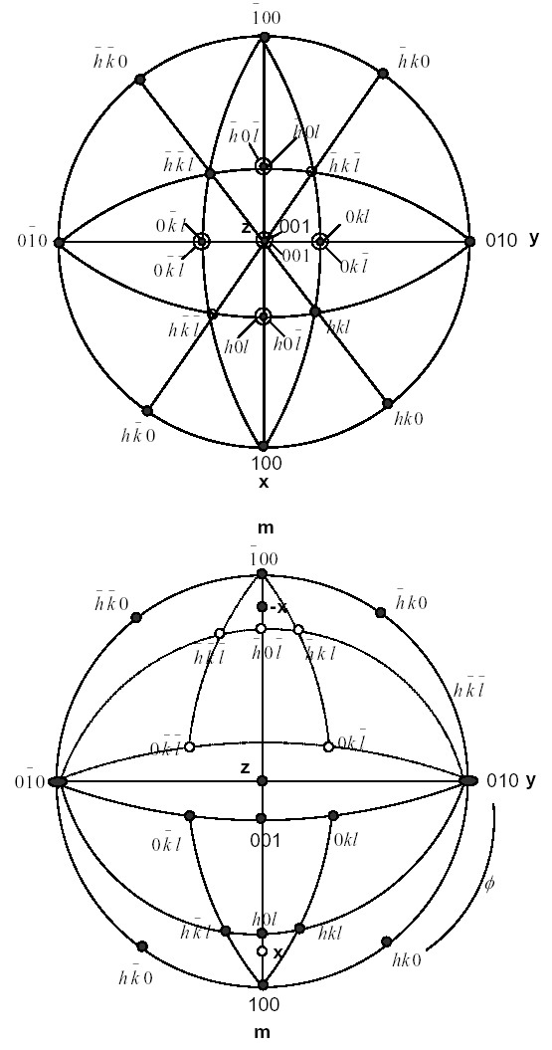
Orthorhombic
Monoclinic

Slide 39
2-5 Two convections used in stereographic
projection
(1) plot directions as poles and planes as
great circles
(2) plot planes as poles and directions as
great circles

Slide 40
2-5-1 find angle between two directions
(a) find a great circle going through them
(b) measure angle by Wulff net

Slide 41
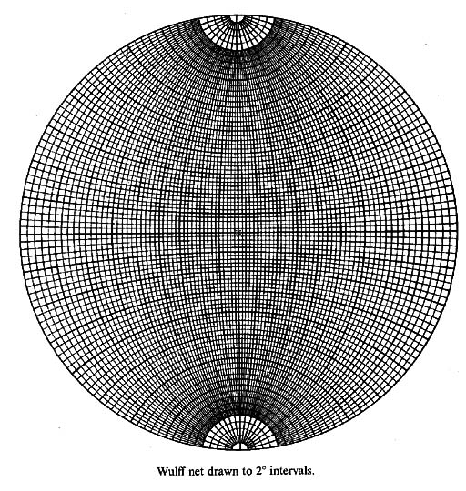
Meridians: great circle
Parallels except the
equator are small circles

Slide 42
Equal angle
with respect
to N or S pole

Slide 43
Measure the angle
between two points:
Bring these two points on
the same great circle;
counting the latitude angle.

Slide 44
(i) If two poles up
(ii) If one pole up, one pole down

Slide 45
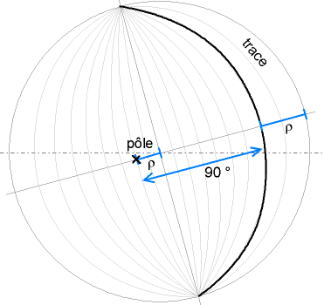
2-5-2 measuring the angle between planes
This is equivalent to measuring angle between poles
Pole and trace
http://en.wikipedia.org/wiki/Pole_figure

Slide 46
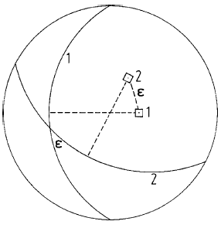
Angle between the planes of two zone circles is the angle
between the poles of the corresponding

Slide 47
use of stereographic projections
(i) plot directions as poles
---- used to measure angle between directions
---- use to establish if direction lie in a particular plane
(ii) plot planes as poles
---- used to measure angles between planes
---- used to find if planes lies in the same zone

